Slide 1
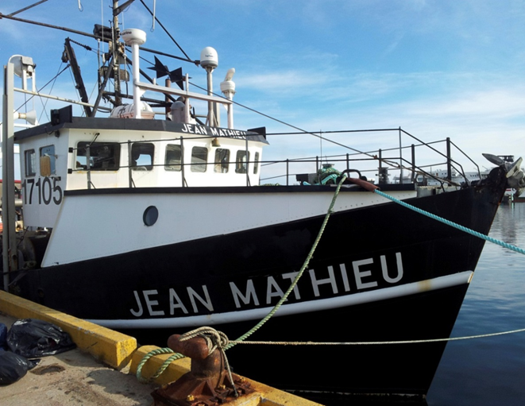
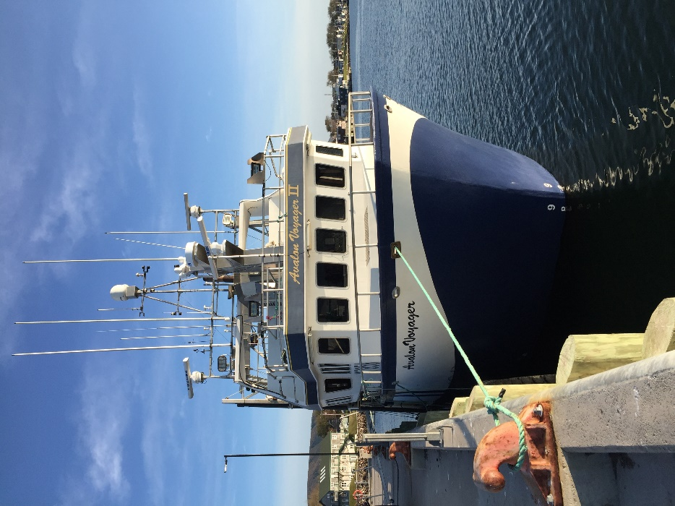
2019 Comparative survey results / Résultats du relevé comparatif 2019
by Tobie Surette
Jean Mathieu
Avalon Voyager II
Notes:
After a run of 6 years, the Jean Mathieu was retired as the sGSL snow crab survey vessel.
The new vessel is the Avalon Voyager II, which perfomed the 2019 survey.
Both vessels are 65-footers, based out of the Magdalen Islands, and belong to the same owner.
The Jean Mathieu has a steel hull and weighs about 100 tonnes, with a 720 hp engine.
The Avalon has a fiberglass hull and weighs about 138 tonnes, with a 850 hp engine.

Slide 2
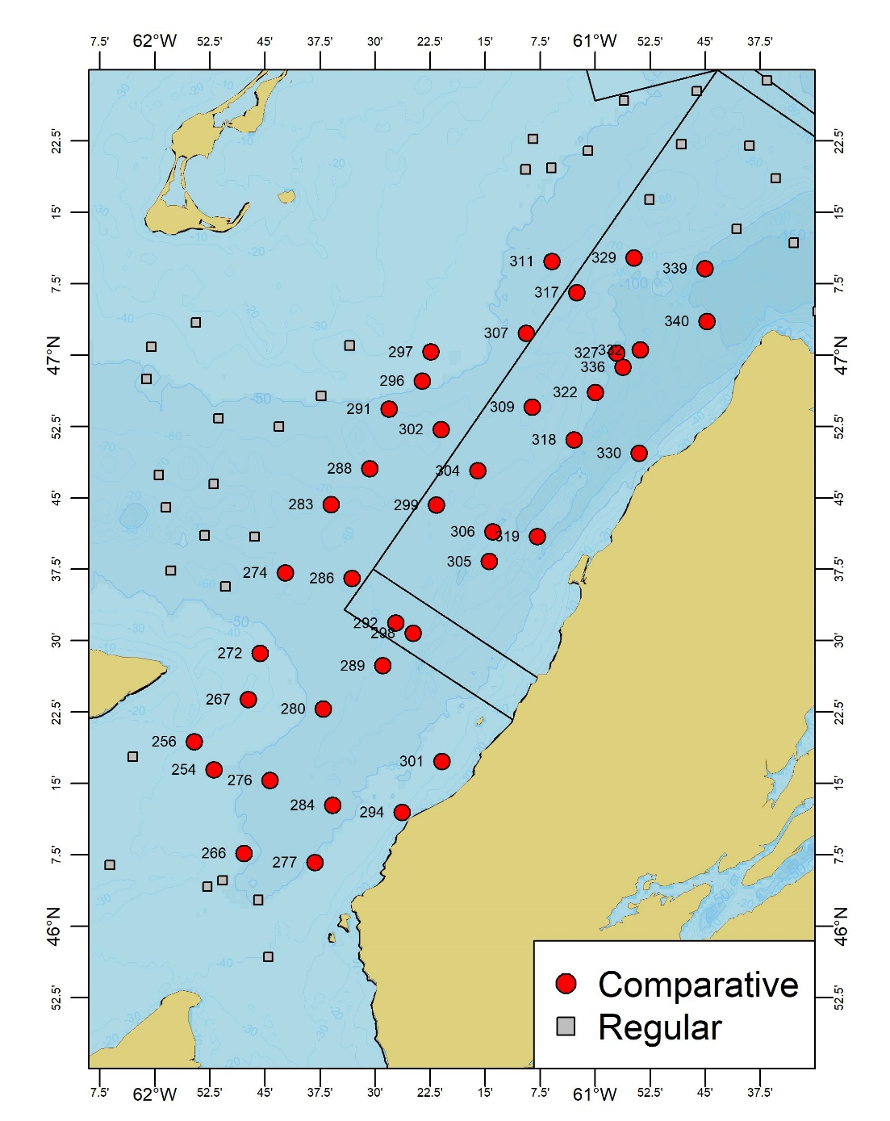
Experimental protocol / Protocole expérimental
End of survey / Fin du relevé (Sept. 19-25).
40 stations.
Side-by-side / Côte-à-côte.
Nephrops trawl / Chalut Nephrops.
5-minute tows / Traits de 5-minutes.
Speed ~2 knots / Vitesse ~2 nœuds.
Notes:
Comparative, side-by-side tows were perfomed at the last 40 stations of the survey (red circles) from Sept. 19th to 25th
Identical fishing gear (Bigouden Nephrops trawl) were used on the two vessels and probes monitored various aspects of the trawl net during fishing.
Stations were chosen based on convenience and their trawlability (i.e. low probability of net damage).
Numbers indicate the tow station numbers.
In the document, all tow summary statistics, including catches are indexed by these station numbers.
The two captains, both from the Magdalen Islands, exchanged vessels on September 24-25.

Slide 3
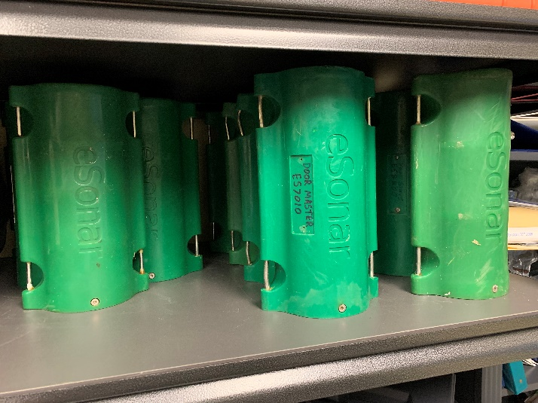
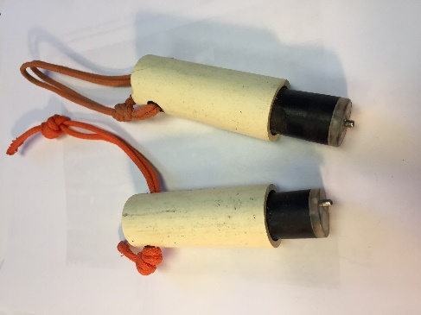
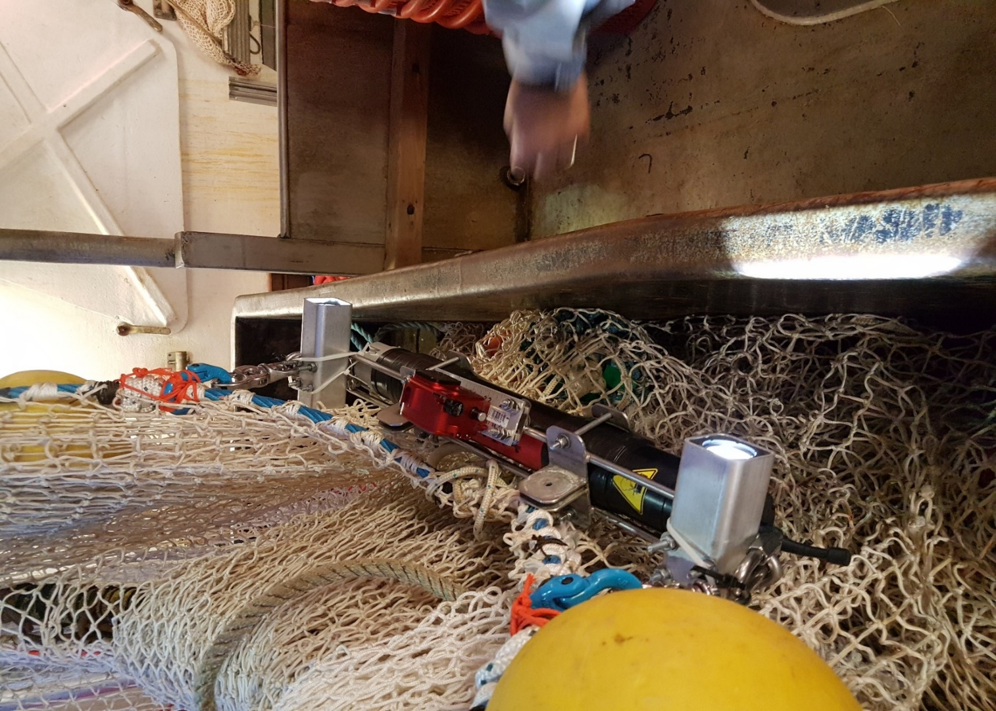
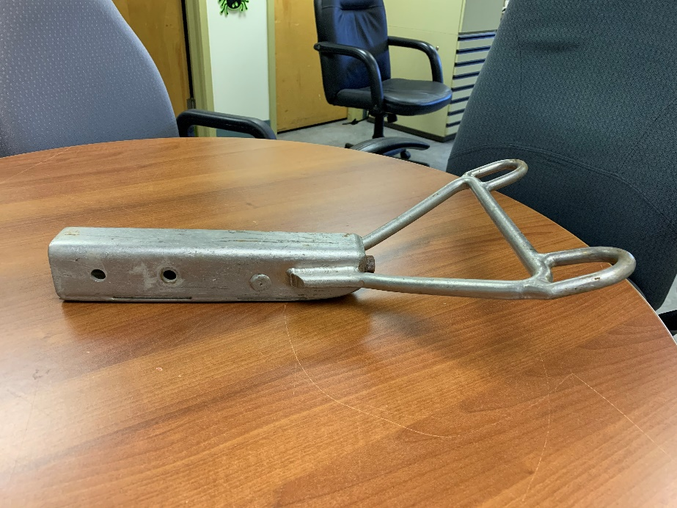
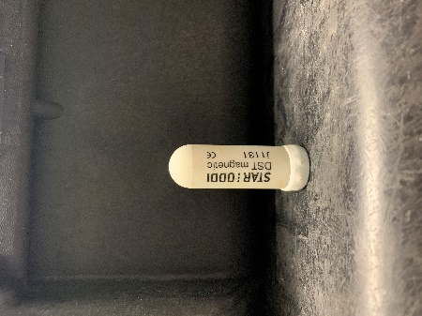
Trawl probes / Sondes du chalut:
Light
GoPro Camera
eSonar
Minilog (1990-2019 R.I.P)
Flowmeter
Light
Star Oddi
Tilt mechanism /
Appareil d’inclinaison
Aquadopp 300
Flowmeter / Courantomètre
Notes:
Here we see photos of the various probes which were used to gather trawl dataon the survey:
eSonar trawl acoustic monitoring probes (green probes, top left)
These are used to provide real-time monitoring of trawl behavior and measure trawl depth, the height of the head line (from the bottom) and the trawl wing spread width.
Star Oddi probes (small white probe, bottom left)
We have two Star Oddi probes, the first is attached to the head line and measures water temperature and pressure.
The second is encased inside a stainless steel mechanism (bottom, center) attached to the foot rope, which serves as our tilt mechanism to detect the trawl touchdown and lift off times.
Flowmeter (right photo)
We had Doppler flowmeters for the comparative survey, to measure current flow at mouth of trawl.
We hope to get more detailed data on changes in incoming water flow rates during trawling, especially at the end of trawling.
We also hoped to get some useful video footage crab being scooped up by the trawl, but we ended up getting no useful footage and two busted cameras and cases (go science).
Minilog:
We bade farewell to our last functional Minilog probe this year (top center). We’ve used these probes since 1990, to record temperature and depth of the trawl, so we corrected our touchdown times using Star Oddi head line probe data this year.

Slide 4
Trawl and probes / Chalut et sondes:
eSonar
Star-Oddi TD
Wing
Star-Oddi Tilt / Incl.
Head line /
Ralinque
supérieure
Height
Depth
Floaters /
flotteurs
Cod end /
cul du chalut
Door / Porte
Wing / Aile
Foot rope /
Ralinque inférieure
Wing
Bridle /
Fourche
Notes:
Here’s a schematic diagram of the trawl and the placement of the probes.
So we call the upper portion of the mouth of trawl (the one with the floaters) the head line, and the lower lines, with the chain and small rubber rollers the foot rope.
Green rectangles are the eSonar probes
a pair of wing spread sensors
A head line height sensor
A depth sensor
Grey rectangles show the placement of the two Star Oddi probes:
One which is attached to the head line and records water temperature and ambient water pressure
The second which is encased in our tilt mechansim and records water pressure, water temperature and tilt angle. It also contained a magnetic compass which recorded the heading of the trawl as it moved.
The flowmeter (not shown here) was attached to the head line – but only for ~20/80 tows, due to device problems and net entanglement issues.

Slide 5
Tow summary example / Rapport sommaire de trait:
Includes / Inclut:
Catch photo / Photo de capture
Vessel track / Trajet de bateau
Vessel speed / Vitesse de bateau
Wing spread / Largeur des ailes
Trawl depth / Profondeur du chalut
Tilt probe angle / Angle d’inclinaison
Heading / Direction
Notes:
All of these probes gather a lot of data so we generate these one-page summaries for each tow, which allows us to characterize at a glance, the progress and events associated with each tow.
So this is an example of a report showing:
Top-left : a photo of the trawl catch, so we can see whether catch composition, whether there were rocks, boulders, mud, debris….
Top-right : Vessel track with the start and end points of the tow.
From the top going down well see different time series observation over the course of the tow.
Speed of the vessel (in this example we have speed oscillations)
The second plot shows the trawl wing spread data. As Renee mentioned, the addition an extra receiver this year improved the quantity and quality of eSonar observations. This is particularly important for for wing spread measurements which are used to estimate the surface area swept by the trawl.
The third panel from the bottom shows the depth profile of the tow for all probes (eSonar + Star Oddi).
The fourth panel shows the tilt angle, from the footrope-attached Star Oddi probe, which clearly show when the trawl touches down and when in lifts off.
The bottom panel shows the heading of the tilt probe, as measured by its magnetic compass (blue), the red line is the angle of inclination with respect to the Earth’ magnetic field.
The touchdown and liftoff times were determined analytically using tilt angle data, which generally provides clear transitions between when the trawl is on or off the bottom.

Slide 6
Trawling phases / Étapes du chalutage:
Depth / Profondeur (m)
Elapsed time / Temps écoulé (min)
Notes:
Some of the discussions we will have in this and Marcel’s presentation will gravitate around various events and phases during the trawling process.
So we will provide a few definitions to help in our discussions.
This diagram shows a typical depth profile for a tow, showing its initial descent through the water column, its touchdown, followed by the active trawling phase, which generally lasts 5 minutes until a stop signal is given. The trawl winches are activated this time and the vessel also slows down.
The extra time the trawl spends on the sea bottom, we refer to as the passive trawling phase
This phases lasts until the the trawl finally lifts off the bottom and ascends back through the water column.
There are three time events to remember: a start time, equated with the touchdown time, a stop time, which is dictated by the chief scientist, followed by a liftoff time some time after the stop time.
Catches in the survey are currently standardized by swept area estimates of the active trawling phase only, but for the purposes of the comparative survey analysis, we estimated the passive phase swept area to see if helped in explaining catch differences between the two vessels.
Take questions at this stage to make sure that everybody is on the same page as to what this diagram is saying.

Slide 7
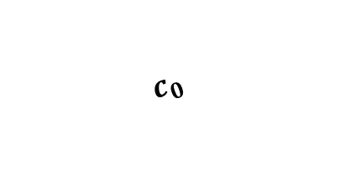
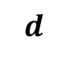
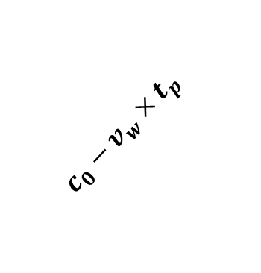

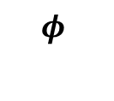

Passive phase analysis / Analyse de la phase passive:
Vessel / Bateau
$$c_{0}$$
Depth / Profondeur
$$c_{0}−{v_{w}×t}_{p}$$
Warp length at liftoff
Warp length at stop position
$$d$$
$$φ≈20°$$
$$φ$$
$$l_{w}$$
Door movement /
Mouvement des portes
Doors at stop position /
Positon des portes à l’arrêt
Doors at liftoff
Portes au décollage
Notes:
So how do we calculate swept area?
For the active trawling phase, it’s calculate by combining trawl speed with wing spread observations. How do we know the trawl speed? The winches are locked, so we can equate trawl speed with vessel speed.
However, the calculation of the passive phase swept area is more complicated, because more forces are acting on it:
The first is the vessel speed and manoeuvers. This turns out not to be an issue, because the survey vessel generally kept the same heading during winching, so the trawl just keeps moving forward in the same direction (as it did during active trawling). This assumption is also supported by trawl heading observations from the foot rope tilt probe.
The second force is that of the winch speed. So how do we know winch speed? Because the haul times, the time required for the doors to breach the surface, were noted (fortuitously) for each tow by the science crew. When combined with the length of warp cable, this gives us an estimate of the average winch speed during hauling.
So this diagram represents the movement of the trawl due to winch action:
Survey vessel at top right
Trawl doors at bottom left.
We target a 3:1 ratio of warp to water depth. For this ratio, under these somewhat idealized conditions, the angle between the cables and the sea bottom is about 20 degrees prior to winching (i.e. at the stop time). At the liftoff, the trawl will have moved by an amount which we can calculate using the winch speed, the duration of the passive phase, the warp cable length and some trigonometry.
The second component of the trawl due to vessel movement can be calculated independently as we did for the active trawling phase.
Adding the winch and vessel distance components together gives us the distance the trawl moved during the passive trawling phase.
These were combined with median estimates of wing spread to give us swept area estimates.

Slide 8
Winch speed / Vitesse du treuil:
Notes:
So here we show the estimated winch speeds for our 40 survey stations, in chronological order, for each captain.
The vertical line shows the date when the captains exchanged vessels.
We see that our captain #2, had generally higher winching speeds while on either vessel, except for a few tows, notably the final 5 tows on the final day of the experiment.
We also note that the winch had to be connected to auxiliary power for a number of tows (tows 8-10).
There is a marked contrast between winch speeds from captain 1 on board the Avalon on the first leg of the survey, which were about 0.9 m/s and those of the 2nd captain on the second leg of the survey, which were at about 1.4-1.5 m/s. These high speeds led to entanglements, so the winch was used at a much slower speed the following day.
The winch speeds on the Jean Mathieu were generally faster than those on the Avalon, which was reflected winch speed patterns observed on the survey as a whole.

Slide 9
Vessels’ tracks / Trajets des bateaux:
Notes:
Here we see the distribution of the vessel tracks of the Jean Mathieu (grey), relative to those of the Avalon Voyager II (red).
Numbers indicate the tow station numbers.
Tracks were shifted and rotated so that the Avalon’s tracks are all centered on the center (0,0) coordinated and rotated to point northward.
This shows that vessels were about 0.5 kilometers apart on average, with the farthest lying at about 1.5 kilometers.

Slide 10
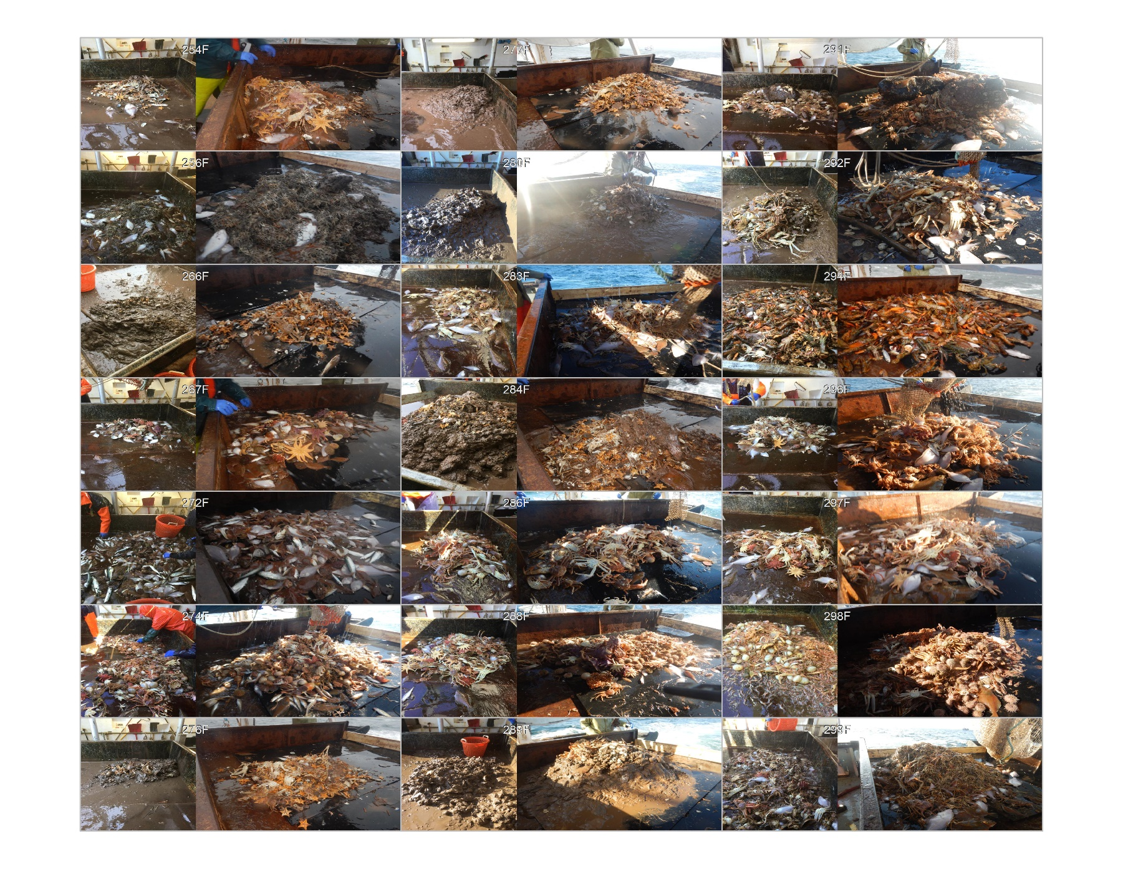
Catches / Captures:
Notes:
So these are photos of some of the catches from each, placed side-by-side. These photos are also in the research document that I provided.
The types of species present at each location were generally very similar between vessels,
except for 3-4 tows which hinted at differences in bottom type (ex. presence of sea potatoes, sea urchins) or temperature differences (lobster)
The photos also allowed for quick assessments of the quantity of debris, rocks and boulders.

Slide 11
Factors considered / Facteurs considérés
Active swept areas (with errors) / Aire balayée de la phase active
Passive swept area (no error) / Aire balayée de la phase passive
Boulders and large rocks / Grosses roches
Notes:
For the analysis, we considered the following factors:
Swept area estimates of the active trawling phase, along with their uncertainty. (from a dedicated hierarchical model).
This model was used to filter out noisy observation and to infer missing ones.
We had many problems with the eSonar on board the Jean Mathieu, which led to missing and noisy wing spread observations.
So swept area estimates for these tows were more uncertain, but this uncertainty was accounted for.
Swept area estimates of the passive trawling phase, along no uncertainty.
The presence of boulders or large rocks was included as a binary predictor (in 4 tows), since their encounter by the trawl often lead to apparent trawl behaviour.

Slide 12
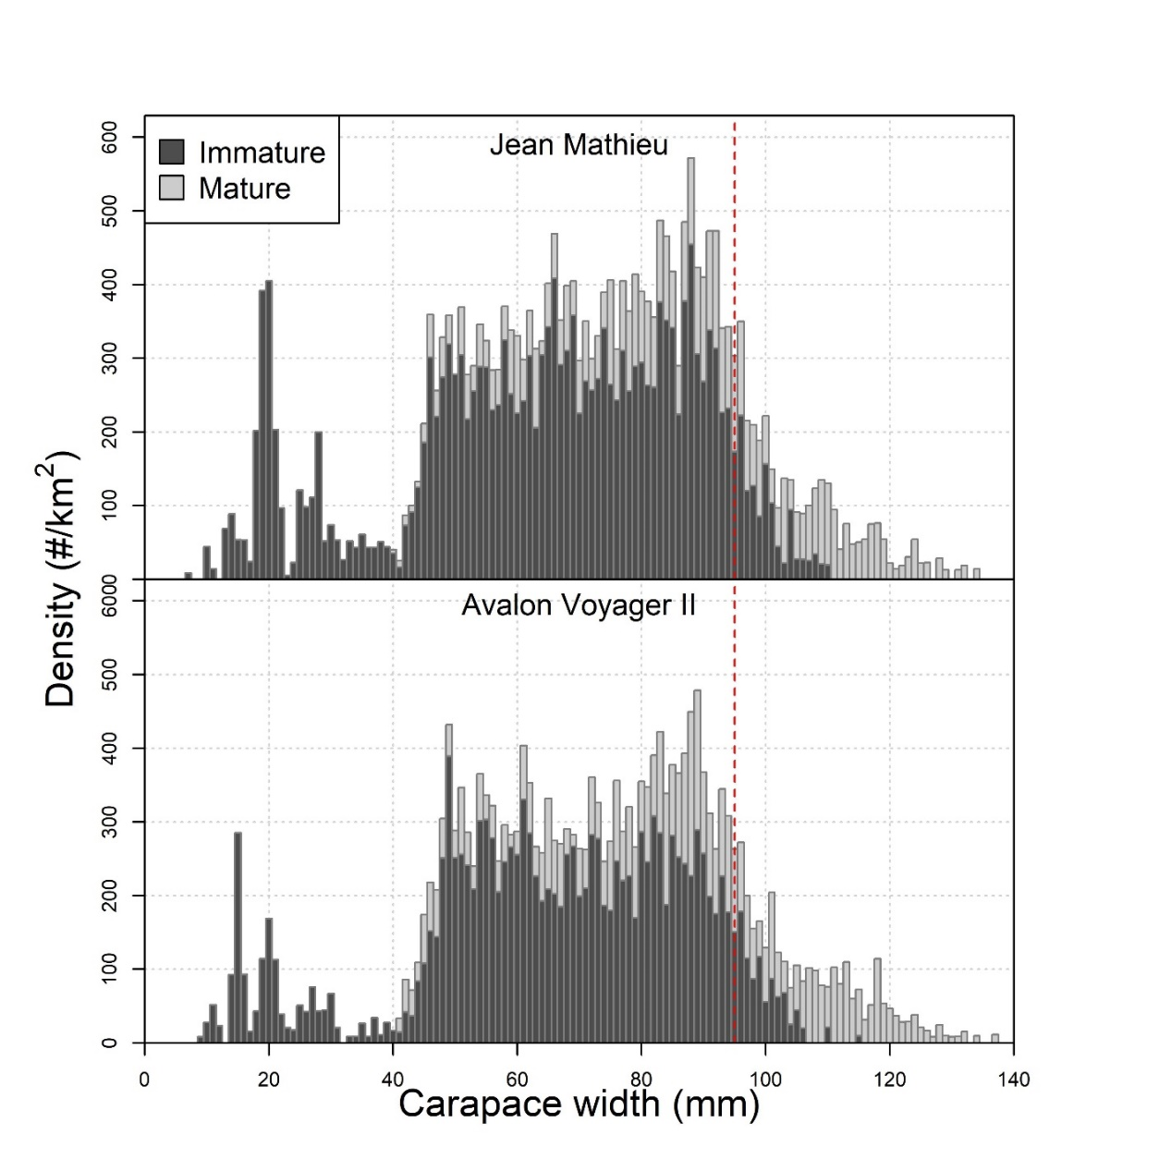
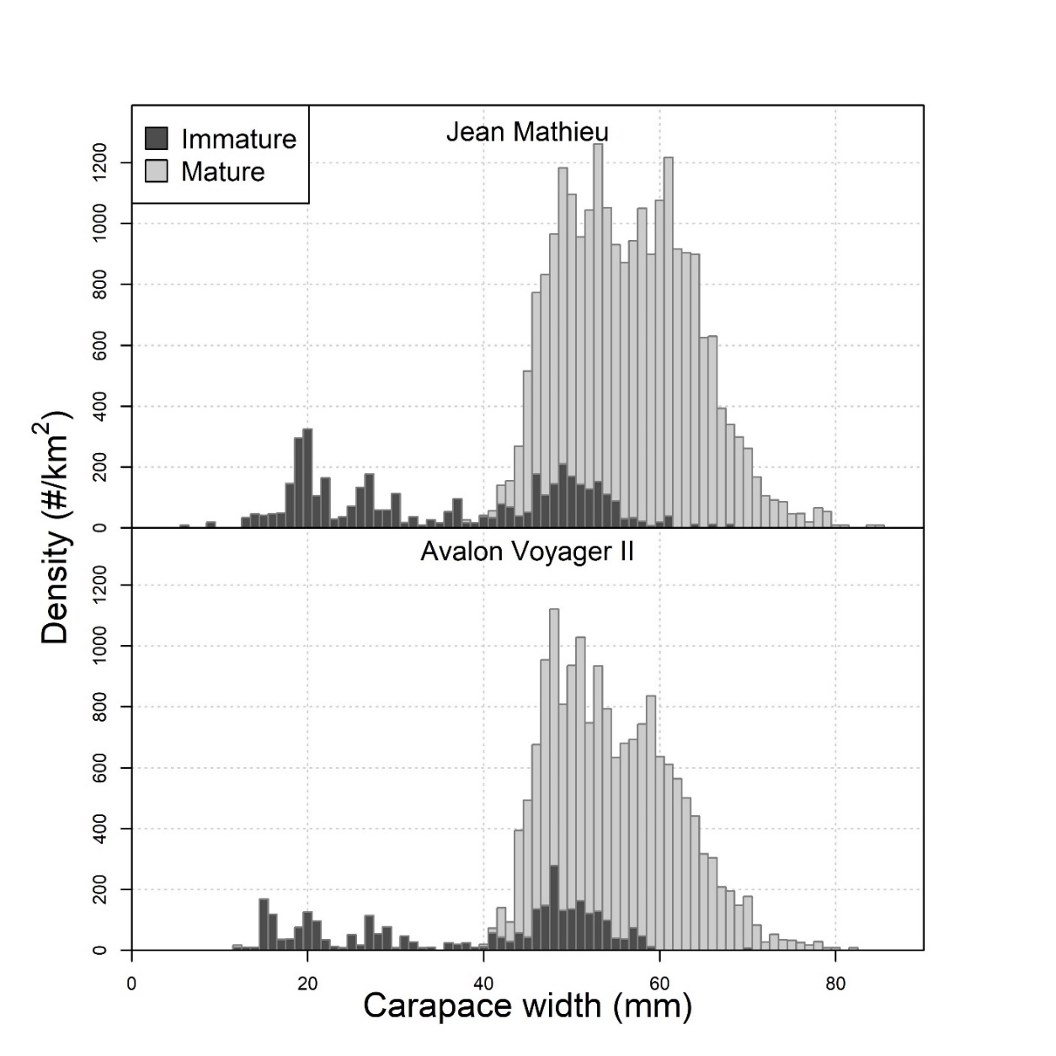
Snow crab length-frequencies / Longueurs-fréquences crabe des neiges :
Males / Mâles
Females / Femelles
Notes:
Here we see the average length-frequency distributions for male (left) and female (right) snow crab for the Jean Mathieu (top panels) and the Avalon Voyager (bottom panels).
Immatures are shown as darker bars and lighter bars indicate mature individuals.
Standardized using active swept areas …
Firstly we see that the distributions are generally similar between the two vessels.
There are apparently lower catch levels of small crab < 40mm for both males and females, though at these sizes, the catchability is very low and moreover expected to be more variable.
In particular, the selectivity at these sizes is an issue, in that its retention in the trawl is a function of the amount/type of debris in the trawl + the amount of flushing by the captain prior to hauling.
Commercial snow crab have comparable levels between the two vessels.
Mature females, especially in the larger size range, are caught more in the JM than the AV.
Intermediate sized males (< 95 and > 60mm CW) seem to follow a similar pattern, being slightly more abundant in JM catches than AV.

Slide 13
Catches / Captures:
Density / Densité (10³/km²)
Density / Densité (10³/km²)
Tow / Trait
Tow / Trait
Notes:
Here we compare overall catches densities for commercial snow crab (left) and mature females (right), for each comparative tow, in chronological order.
The solid orange line shows catches for the Jean Mathieu and the dashed blue line for the Avalon.
Commercial catches, though variable, were comparable between the two vessels, though commercial males tend to not be very numerous in survey catches (0-21 animals during the comparative).
Mature females catch levels were quite variable, from 0 to 556 females in a single catch, and was caught more on the Jean Mathieu than the Avalon.

Slide 14
Results : Snow crab Résultats : Crabe des neiges
Vessel effect / Effet bateau
Notes:
Here we see the boxplots for the estimated vessel for 5 snow crab categories.
The red horizontal line, centered on zero, represents no catch differences between vessels.
The credibility intervals for the 3 categories on the left: commercial, immature males and mature males, show no significant catch differences between vessels.
In contrast, the credibility intervals for immature and mature females, on the right, show significantly higher catch rates for the Jean Mathieu relative to the Avalon.
At the median level, this corresponds to 50% higher catches in the Jean Mathieu for females.

Slide 15
Results : Fish & invertebrates Résultats : Poissons et invertébrés
Fish / Poisson
Invertebrates / Invertébrés
Notes:
We also performed the analyses for a few fish and invertebrate species.
Fish species showed no significant catch differences between vessels for the three fish species considered: Atl cod, Amercian plaice and Yellowtail flounder.
In particular, American plaice which were caught at most sampling locations and was fairly abundant, and whose habitat strongly overlaps with snow crab, shows no signifcant differences.
Among the 6 invertebrate species considered, only mudstars and sea urchins showed significant differents, but in opposite directions.
Mudstars were seeimingly favoured by the Avalon, while urchins catches were larger on the Jean Mathieu.
So what should we make of this odd significance patterns?
One thing to consider is the degree of aggregation :
Female snow crab, mud stars and sea urchins show a high degree of spatial aggregation.
For snow crab, it is thought that males spread out more because they tend to establish territories, whereas females tend to cluster more in certain locations.
Spatial aggregation makes the analysis more susceptible to violations of statistical independence. e.g. the trawl for some unaccounted reason is not performing optimally in a region where females are abundant.

Slide 16
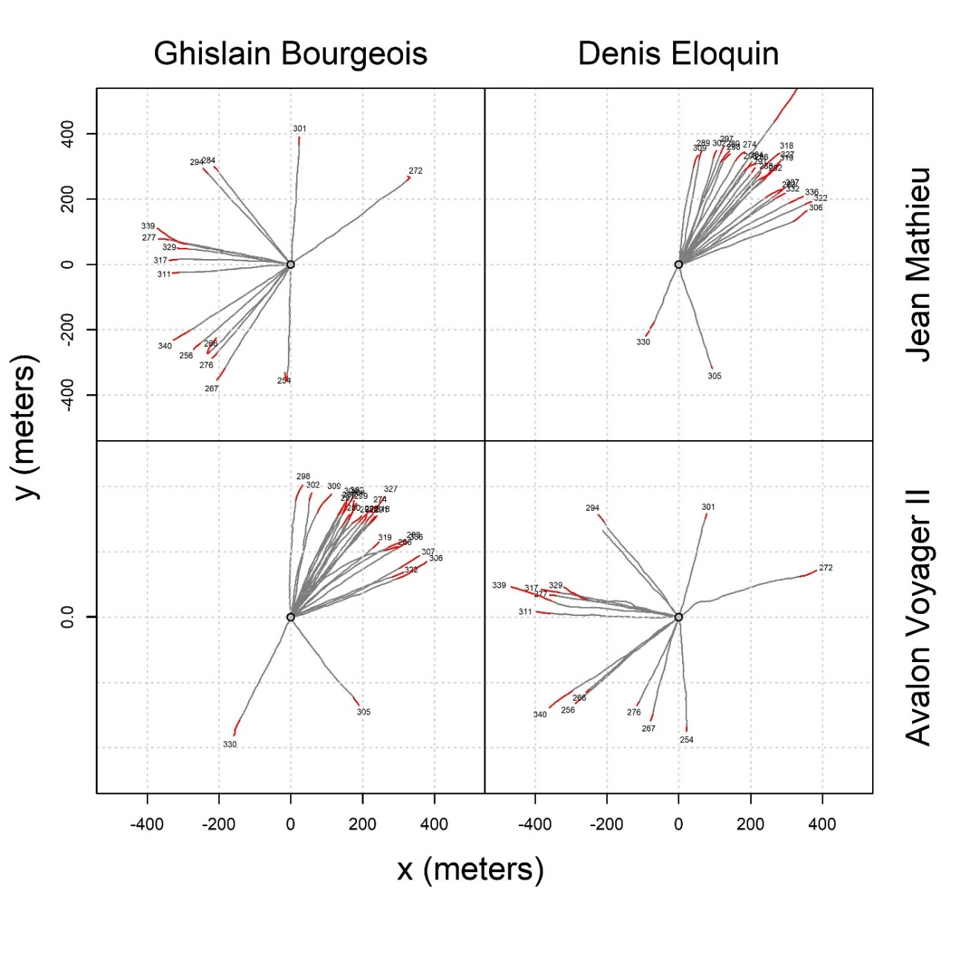
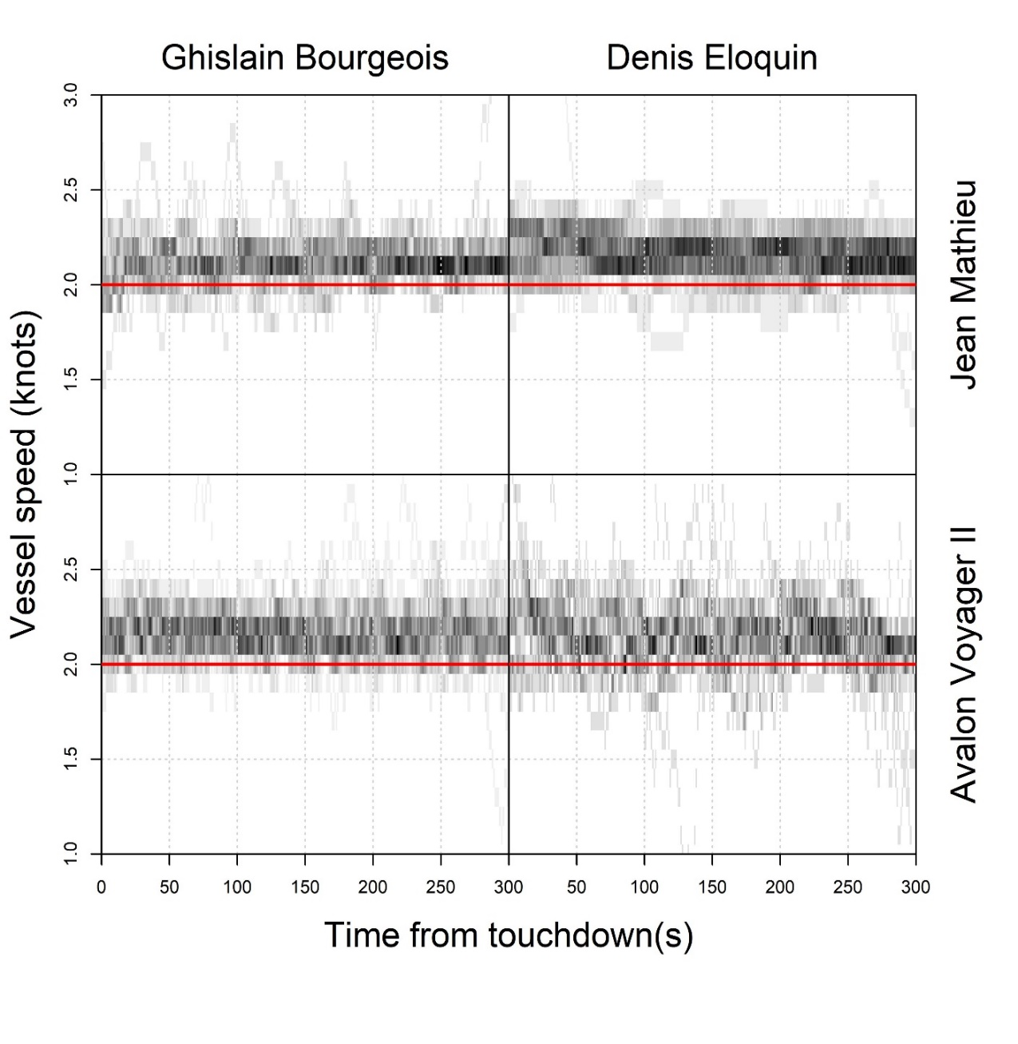
Other possible factors / Autres facteurs possibles:
Captain 1
Captain 2
Captain 1
Captain 2
Notes:
To give some sense of possible variations in fishing practice, we will see four different plots showing different aspects of the survey vessel and trawl.
Each plot separates the data by captain (left and right columns) and vessel, with Jean Mathieu in the top row and the Avalon on the bottom row.
Tracks:
The plot to the left shows each vessel track by captain and vessel.
All tracks were shifted so that they all start at the same point.
The grey portion of the track represents the active trawling phase and the red portion, the passive trawling phase.
So we can compare the track lengths between vessels, their directions, whether the vessel deviated from its course, etc…
For the comparative survey, the track lengths of the active and passive phases were fairly similar in extent, and so were their swept areas.
We also note that one tow on the Jean Mathieu had a start time which was revised downward, due to a malfunctioning eSonar, resulting in a much longer tow.
Speeds:
On the right we have a plot showing the vessel speeds during active trawling for all the tows, overlayed so that darker shades indicate more observations.
Note that rather large fluctuations exist for particular tows.
In particular the variability of the captain 2 on the Avalon is relatively high.
Speeds on average are about 2.1-2.2 knots.

Slide 17
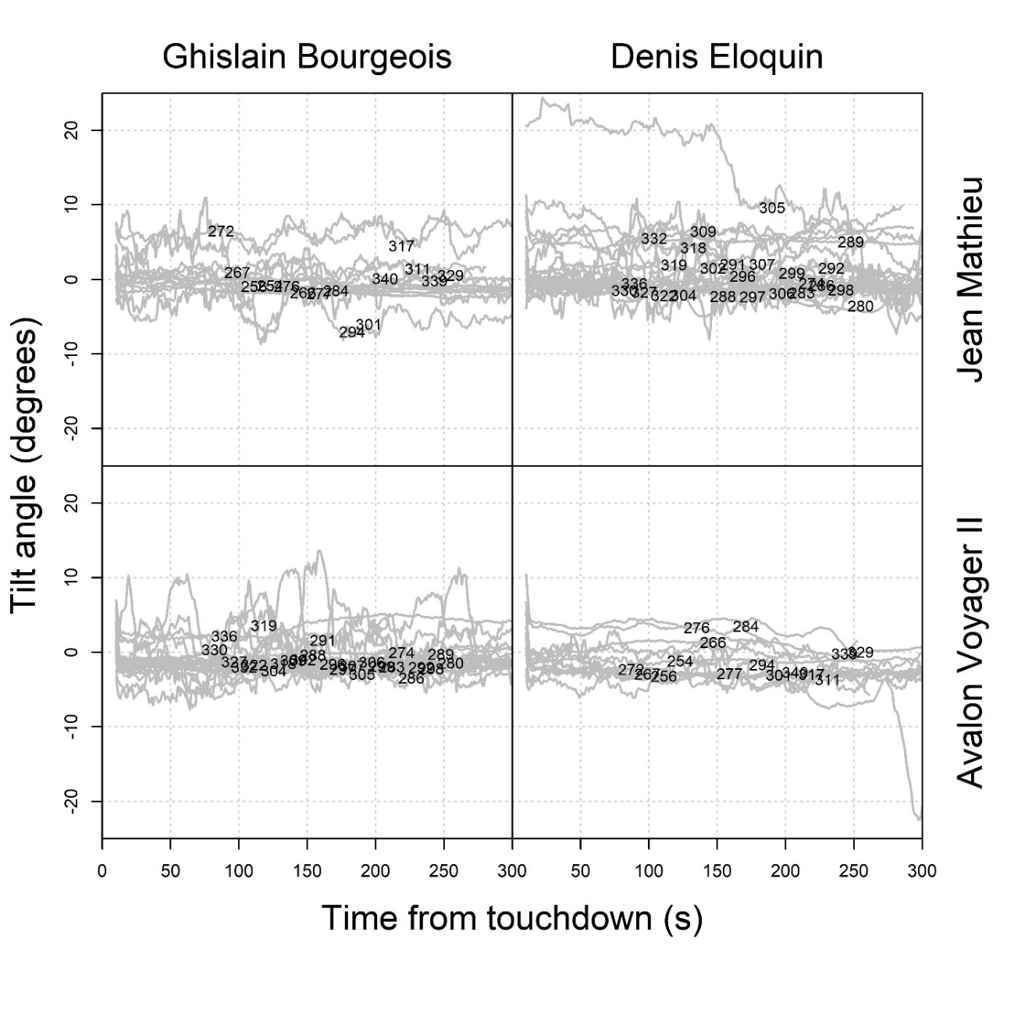
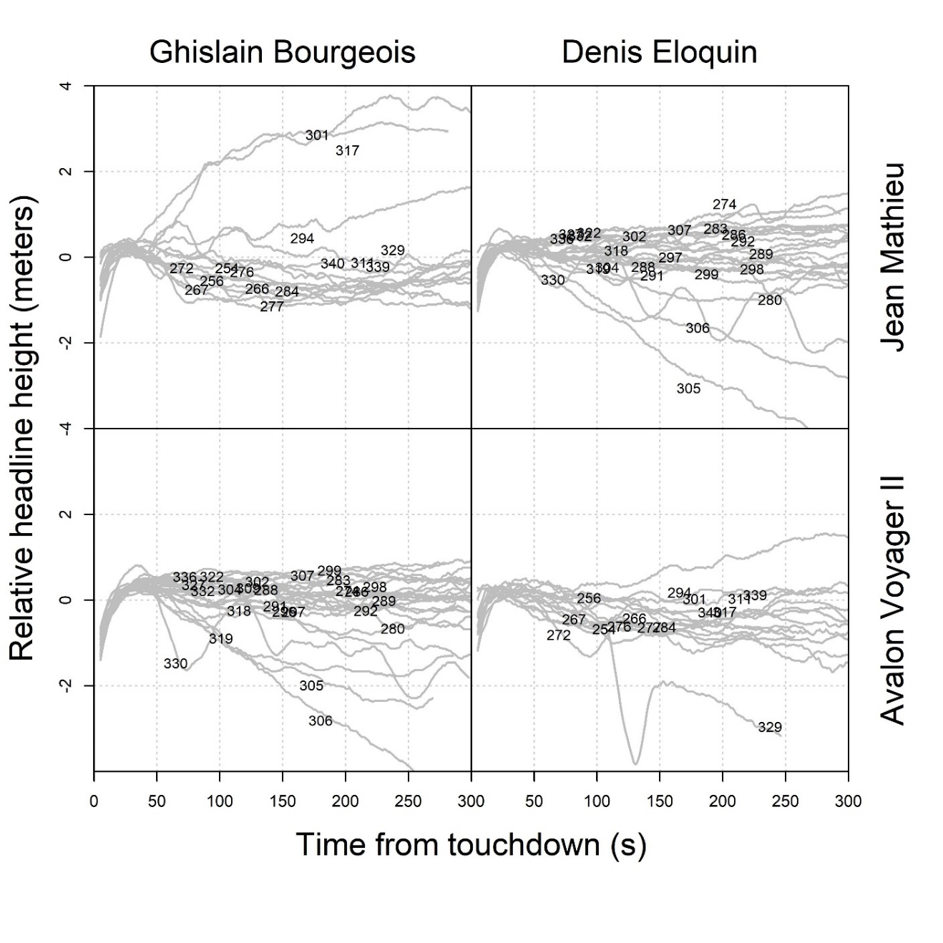
Other possible factors / Autres facteurs possibles:
Captain 1
Captain 2
Captain 1
Captain 2
Notes:
Here we have two plots which stem from tow observations:
Tilt angle:
The left plot shows tilt angle observations for each tow.
The devil may be in the details, and it remains well anchored in the back of my mind that factors such as these, and other unobserved ones, in addition to spatial heterogeneity, may be driving catch differences between the two vessels.

Slide 18
Conclusions:
No differences between male snow crab catches.
Signficantly higher catches for immature and mature females on Jean Mathieu.
Fish had similar catch levels.
Sea urchins were caught more on Jean Mathieu, but mudstars more the Avalon.
However, uncertainties remain, such as:
Trawl speed oscillations
Bottom contact
Large catch increases observed in 2019 survey, notably for mature females
Captures de mâles montrent des différences non-significatives .
Captures plus élevées chez les femelles immatures et matures du Jean Mathieu.
Les captures de poisson étaient comparables.
Plus d’oursins de mer sur le Jean Mathieu, mais plus de mudstars sur l’Avalon.
Il reste quand certaines incertitudes, telles que:
Oscillations dans la vitesse du chalut.
Contact avec le fond
Grosses augmentations des captures dans le relevé de 2019, notamment chez les femelles matures
Notes:
So what can we conclude from this analysis?
Passive swept area coda:
Passive swept area was hoped to be the lense through which the differences between catches would be brought into focus, but this was not the case.
Removing passive swept area did not significantly change any of the results.
Do this mean that the passive swept area is irrelevant?
Not necessarily. The catchability of the trawl during the passive phase may be highly variable from tow to tow. Notably,
We do not know at which point the doors lift off … i.e. there may be an offset between the lifting off of the doors and the lifting off of the footrope.
Asymmetry between the doors and wings may be quite variable during this phase, which would lead to potentially large differences in effective swept area which are currently unaccounted for.
So the problem may lie in the variability of these unquantified effects, which could bias the swept area estimates.
These worries may partially extend to the active trawling phase which, as we have seen, was subject to varying levels of speed oscillations, which may have led to varying levels of bottom contact.

